Slide 1
Schrodinger Solver
Presenter : Jerry Lin
Advisor : Prof. Hiroshi Watanabe

Slide 2


Discretization of Schrodinger Equation
Time-independent Schrodinger equation
V(x)
$$\frac{{−ℏ}^{2}}{2m}\frac{d^{2}}{{dx}^{2}}φ\left(x\right)+V\left(x\right)φ\left(x\right)=Eφ\left(x\right)$$
$$φ\left(x\right)$$
x

Slide 3













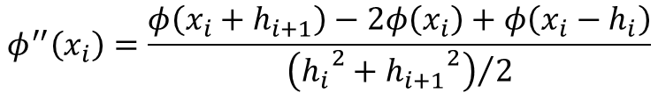
Discretization of Schrodinger Equation
$$φ\left(x_{i}+h_{i+1}\right)=φ\left(x_{i}\right)+φ^{′}\left(x_{i}\right)h_{i+1}+\frac{φ^{′′}\left(x_{i}\right)}{2}{h_{i+1}}^{2}$$
Non-uniform mesh
$$φ\left(x_{i}−h_{i}\right)=φ\left(x_{i}\right)−φ^{′}\left(x_{i}\right)h_{i}+\frac{φ^{′′}\left(x_{i}\right)}{2}{h_{i}}^{2}$$
$$φ\left(x\right)$$
$$φ_{i+1}$$
$$φ_{i}$$
$$φ_{i−1}$$
$$h_{i}$$
$$h_{i+1}$$
$$φ^{′}\left(x_{i}\right)=\frac{φ\left(x_{i}+h_{i+1}\right)−φ\left(x_{i}+h_{i+1}\right)}{h_{i}+h_{i+1}}$$
x
$$x_{0}$$
$$x_{i−1}$$
$$x_{i}$$
$$x_{i+1}$$
$$x_{N}$$
$$φ^{′′}\left(x_{i}\right)=\frac{φ\left(x_{i}+h_{i+1}\right)−2φ\left(x_{i}\right)+φ\left(x_{i}−h_{i}\right)}{{\left({h_{i}}^{2}+{h_{i+1}}^{2}\right)}/2}$$
N+1 points

Slide 4


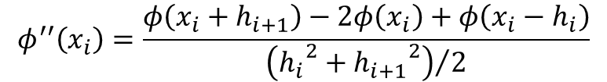

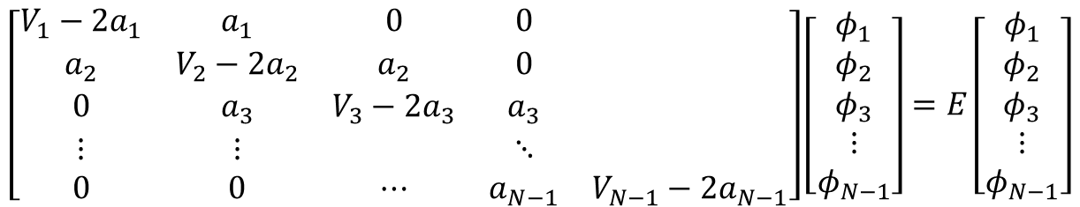
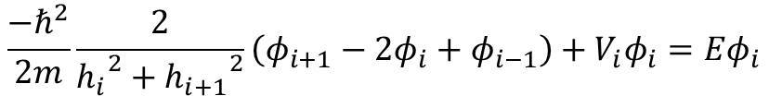
Discretization of Schrodinger Equation
$$\frac{{−ℏ}^{2}}{2m}\frac{d^{2}}{{dx}^{2}}φ\left(x\right)+V\left(x\right)φ\left(x\right)=Eφ\left(x\right)$$
$$φ^{′′}\left(x_{i}\right)=\frac{φ\left(x_{i}+h_{i+1}\right)−2φ\left(x_{i}\right)+φ\left(x_{i}−h_{i}\right)}{{\left({h_{i}}^{2}+{h_{i+1}}^{2}\right)}/2}$$
$$\frac{{−ℏ}^{2}}{2m}\frac{2}{{h_{i}}^{2}+{h_{i+1}}^{2}}\left(φ_{i+1}−2φ_{i}+φ_{i−1}\right)+V_{i}φ_{i}=Eφ_{i}$$
Let $a_{i}=\frac{−ℏ^{2}}{m\left({h_{i}}^{2}+{h_{i+1}}^{2}\right)};φ_{0}=φ_{N}=0$
Bound states
$$\left[\begin{matrix}V_{1}−2a_{1} & a_{1} & 0 & 0 & \\ a_{2} & V_{2}−2a_{2} & a_{2} & 0 & \\ 0 & a_{3} & V_{3}−2a_{3} & a_{3} & \\ ⋮ & ⋮ & & ⋱ & \\ 0 & 0 & ⋯ & a_{N−1} & V_{N−1}−2a_{N−1}\end{matrix}\right]\left[\begin{matrix}φ_{1} \\ φ_{2} \\ φ_{3} \\ ⋮ \\ φ_{N−1}\end{matrix}\right]=E\left[\begin{matrix}φ_{1} \\ φ_{2} \\ φ_{3} \\ ⋮ \\ φ_{N−1}\end{matrix}\right]$$
$$Aφ=Eφ$$
A is a (N-1) by (N-1) matrix
Suitable for 1D, 2D and 3D.

Slide 5

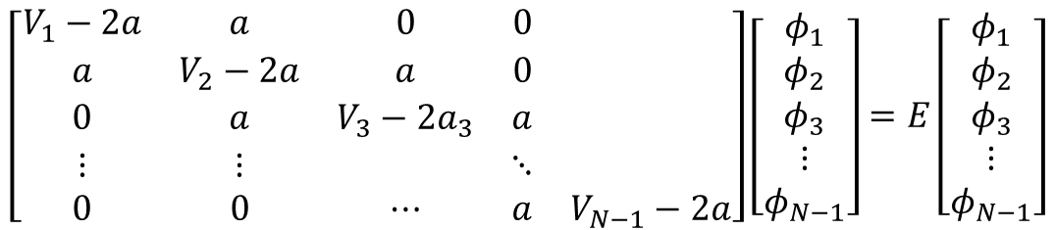

Discretization of Schrodinger Equation
$$h_{i}=h_{i+1}=h; a=\frac{−ℏ^{2}}{2mh^{2}}$$
If we use uniform mesh
$$Aφ=Eφ$$
(Eigenvalue problem)
$$\left[\begin{matrix}V_{1}−2a & a & 0 & 0 & \\ a & V_{2}−2a & a & 0 & \\ 0 & a & V_{3}−2a_{3} & a & \\ ⋮ & ⋮ & & ⋱ & \\ 0 & 0 & ⋯ & a & V_{N−1}−2a\end{matrix}\right]\left[\begin{matrix}φ_{1} \\ φ_{2} \\ φ_{3} \\ ⋮ \\ φ_{N−1}\end{matrix}\right]=E\left[\begin{matrix}φ_{1} \\ φ_{2} \\ φ_{3} \\ ⋮ \\ φ_{N−1}\end{matrix}\right]$$
A is a real, symmetric, and full rank matrix. $(A^{T}=A)$

Slide 6


Numerov Algorithm
If we consider the following differential equation,
$$\frac{d^{2}φ}{{dx}^{2}}+q\left(x\right)φ\left(x\right)=s\left(x\right)$$
With uniform mesh,
$$φ\left(x_{i}+h\right)=φ\left(x_{i}\right)+φ^{′}\left(x_{i}\right)h+\frac{φ^{′′}\left(x_{i}\right)}{2}h^{2}+\frac{φ^{′′′}\left(x_{i}\right)}{3!}h^{3}+\frac{φ^{′′′′}\left(x_{i}\right)}{4!}h^{4}⋯$$
$$φ\left(x_{i}−h\right)=φ\left(x_{i}\right)−φ^{′}\left(x_{i}\right)h+\frac{φ^{′′}\left(x_{i}\right)}{2}h^{2}−\frac{φ^{′′′}\left(x_{i}\right)}{3!}h^{3}+\frac{φ^{′′′′}\left(x_{i}\right)}{4!}h^{4}⋯$$
$$φ_{i+1}−2φ_{i}+φ_{i−1}=h^{2}φ_{i}^{′′}+\frac{h^{4}}{4!}φ_{i}^{′′′′}+𝒪\left(h^{6}\right)$$

Slide 7

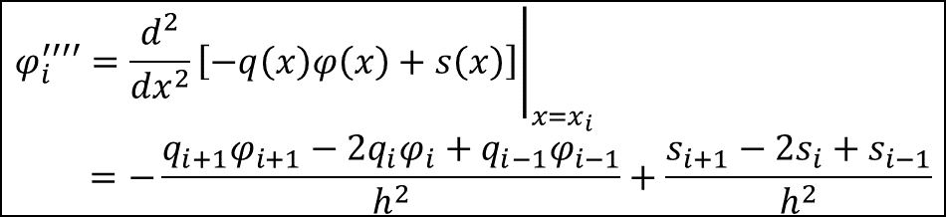

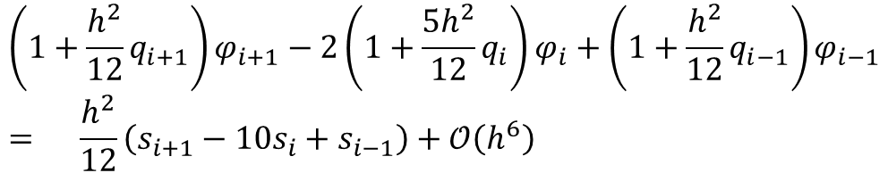

Numerov Algorithm
$$\frac{d^{2}φ}{{dx}^{2}}+q\left(x\right)φ\left(x\right)=s\left(x\right)$$
$$φ_{i}^{′′′′}={\left.\frac{d^{2}}{{dx}^{2}}\left[−q\left(x\right)φ\left(x\right)+s\left(x\right)\right]\right|}_{x=x_{i}} \\ =−\frac{q_{i+1}φ_{i+1}−2q_{i}φ_{i}+q_{i−1}φ_{i−1}}{h^{2}}+\frac{s_{i+1}−2s_{i}+s_{i−1}}{h^{2}}$$
$$φ_{i}^{′′}=−q_{i}φ_{i}+s_{i}$$
$$φ_{i+1}−2φ_{i}+φ_{i−1}=h^{2}φ_{i}^{′′}+\frac{h^{4}}{4!}φ_{i}^{′′′′}+𝒪\left(h^{6}\right)$$
$$\left(1+\frac{h^{2}}{12}q_{i+1}\right)φ_{i+1}−2\left(1+\frac{5h^{2}}{12}q_{i}\right)φ_{i}+\left(1+\frac{h^{2}}{12}q_{i−1}\right)φ_{i−1} \\ = \frac{h^{2}}{12}\left(s_{i+1}−10s_{i}+s_{i−1}\right)+𝒪\left(h^{6}\right)$$
Suitable for 1D.

Slide 8
Numerical Methods for Eigenvalue Problem
Power Iteration
Inverse Iteration
Simultaneous Iteration
QR Algorithm

Slide 9
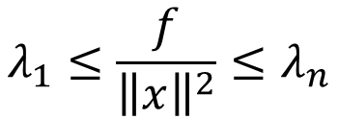

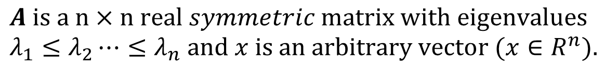

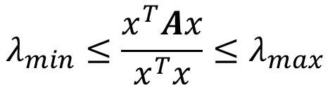

Rayleigh Quotient
$$λ_{min}≤\frac{x^{T}Ax}{x^{T}x}≤λ_{max}$$
Proof:
$$A is a n×n real symmetric matrix with eigenvalues \\ λ_{1}≤λ_{2}⋯≤λ_{n} and x is an arbitrary vector (x∈R^{n}).$$
$$A=SDS^{−1},S^{−1}=S^{T}, let x=Sy, and f=x^{T}Ax$$
$$f=x^{T}Ax=y^{T}S^{T}ASy=y^{T}S^{T}SDS^{−1}Sy=y^{T}Dy$$
$$f=λ_{1}y_{1}^{2}+λ_{2}y_{2}^{2}+⋯+λ_{n}y_{n}^{2}$$
$$λ_{1}≤\frac{f}{{\left\|x\right\|}^{2}}≤λ_{n}$$
$$λ_{1}{\left\|y\right\|}^{2}≤f≤λ_{n}{\left\|y\right\|}^{2}$$
$${\left\|x\right\|}^{2}=y^{T}S^{T}Sy={\left\|y\right\|}^{2}$$

Slide 10
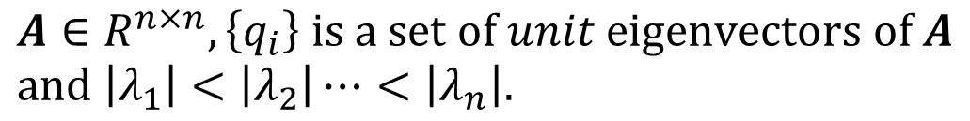
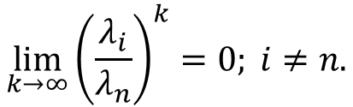
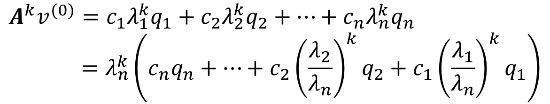
Power Iteration
$$A∈R^{n×n},\left\{q_{i}\right\} is a set of unit eigenvectors of A \\ and \left|λ_{1}\right|<\left|λ_{2}\right|⋯<\left|λ_{n}\right|.$$
$$An intinal guess v^{(0)} can be expressed as:$$
$$v^{(0)}=c_{1}q_{1}+c_{2}q_{2}+⋯+c_{n}q_{n}; assume c_{n}≠0$$
$$A^{k}v^{(0)}=c_{1}λ_{1}^{k}q_{1}+c_{2}λ_{2}^{k}q_{2}+⋯+c_{n}λ_{n}^{k}q_{n} \\ =λ_{n}^{k}\left(c_{n}q_{n}+⋯+c_{2}{\left(\frac{λ_{2}}{λ_{n}}\right)}^{k}q_{2}+c_{1}{\left(\frac{λ_{1}}{λ_{n}}\right)}^{k}q_{1}\right)$$
$$\lim_{k→∞}{{\left(\frac{λ_{i}}{λ_{n}}\right)}^{k}}=0; i≠n.$$

Slide 11
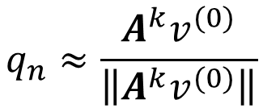

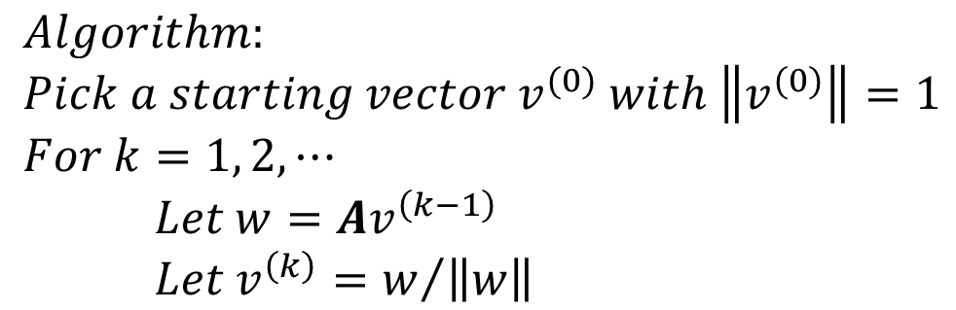
Power Iteration
$$q_{n}≈\frac{A^{k}v^{(0)}}{\left\|A^{k}v^{(0)}\right\|}$$
$$A^{k}v^{(0)}≈c_{n}λ_{n}^{k}q_{n}$$
$$Algorithm: \\ Pick a starting vector v^{(0)} with \left\|v^{(0)}\right\|=1 \\ For k=1, 2, ⋯$$ $Let w=Av^{\left(k−1\right)}$ $Let v^{\left(k\right)}=w/{\left\|w\right\|}$
Remarks:
Only the eigenvector that corresponding to the largest eigenvalue is found.
Convergence depending on the ratio of the two largest eigenvalues.

Slide 12
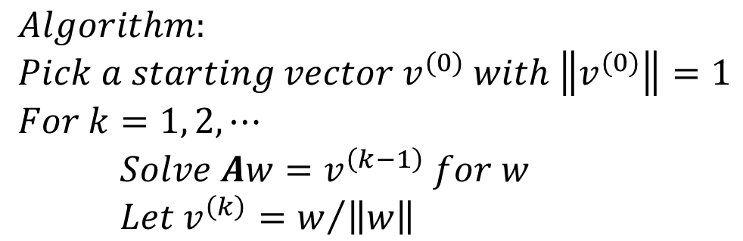
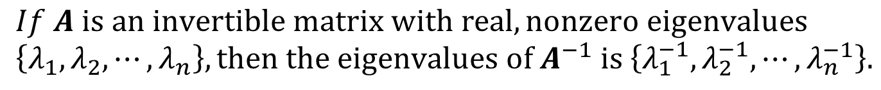
Inverse Iteration
$$If A is an invertible matrix with real, nonzero eigenvalues \\ \left\{λ_{1},λ_{2},⋯, λ_{n}\right\}, then the eigenvalues of A^{−1} is \left\{λ_{1}^{−1},λ_{2}^{−1},⋯,λ_{n}^{−1}\right\}.$$
$$Algorithm: \\ Pick a starting vector v^{(0)} with \left\|v^{(0)}\right\|=1 \\ For k=1, 2, ⋯$$ $Solve Aw=v^{\left(k−1\right)} for w$ $Let v^{\left(k\right)}=w/{\left\|w\right\|}$

Slide 13



Simultaneous Iteration
$$v^{(0)}=c_{1}q_{1}+c_{2}q_{2}+⋯+c_{n}q_{n}$$
$$V^{(0)}=\left[v_{1}^{(0)},v_{2}^{(0)},⋯v_{n}^{(0)}\right]$$
Random initial guess
$$V^{(k)}=A^{(k)}V^{(k)}=\left[v_{1}^{(k)},v_{2}^{(k)},⋯v_{n}^{(k)}\right]$$
Possibly all in the same direction
But if we start with an initial guess that has all vectors perpendicular to each other…

Slide 14
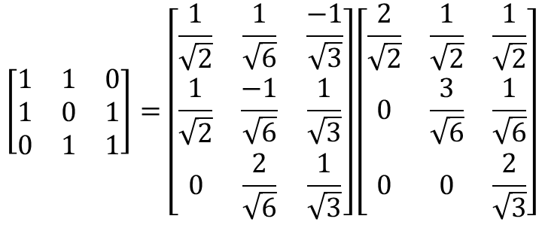
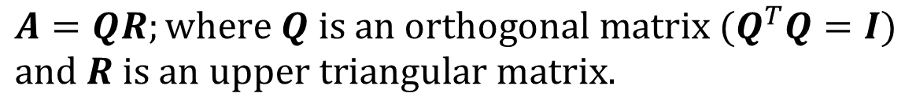
Simultaneous Iteration
Review: QR decomposition
(Gram–Schmidt, Householder transformation, …)
$$A=QR;where Q is an orthogonal matrix (Q^{T}Q=I) \\ and R is an upper triangular matrix.$$
e.g.
$$\left[\begin{matrix}1 & 1 & 0 \\ 1 & 0 & 1 \\ 0 & 1 & 1\end{matrix}\right]=\left[\begin{matrix}\frac{1}{\sqrt{2}} & \frac{1}{\sqrt{6}} & \frac{−1}{\sqrt{3}} \\ \frac{1}{\sqrt{2}} & \frac{−1}{\sqrt{6}} & \frac{1}{\sqrt{3}} \\ 0 & \frac{2}{\sqrt{6}} & \frac{1}{\sqrt{3}}\end{matrix}\right]\left[\begin{matrix}\frac{2}{\sqrt{2}} & \frac{1}{\sqrt{2}} & \frac{1}{\sqrt{2}} \\ 0 & \frac{3}{\sqrt{6}} & \frac{1}{\sqrt{6}} \\ 0 & 0 & \frac{2}{\sqrt{3}}\end{matrix}\right]$$
If A is invertible, then the factorization is unique.

Slide 15
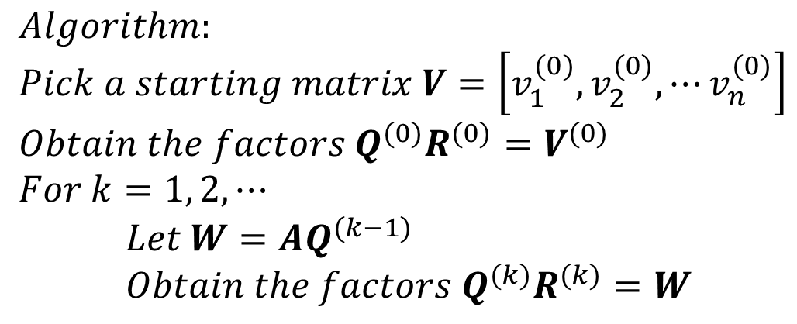
Simultaneous Iteration
$$Algorithm: \\ Pick a starting matrix V=\left[v_{1}^{(0)},v_{2}^{(0)},⋯v_{n}^{(0)}\right] \\ Obtain the factors Q^{(0)}R^{(0)}=V^{(0)} \\ For k=1, 2, ⋯$$ $Let W=AQ^{(k−1)}$ $Obtain the factors Q^{(k)}R^{(k)}=W$

Slide 16
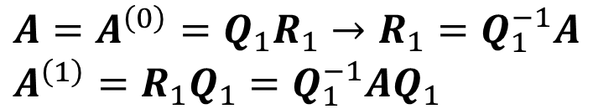
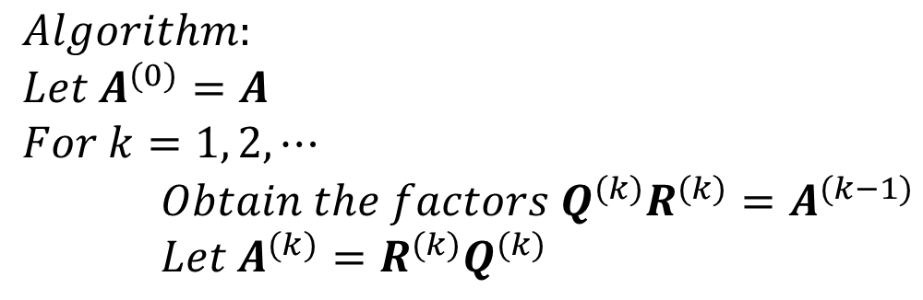
QR Algorithm
For a real, symmetric, and full rank matrix A, we can obtain all its eigenvectors as follows.
$$Algorithm: \\ Let A^{(0)}=A \\ For k=1, 2, ⋯$$ $Obtain the factors Q^{(k)}R^{(k)}=A^{(k−1)}$ $Let A^{(k)}=R^{(k)}Q^{(k)}$
$$A=A^{\left(0\right)}=Q_{1}R_{1}→R_{1}=Q_{1}^{−1}A \\ A^{\left(1\right)}=R_{1}Q_{1}=Q_{1}^{−1}AQ_{1}$$
A^{(k)} and A are similar.
(Same eigenvalues.)

Slide 17

















QR Algorithm
Simultaneous Iteration
QR Algorithm
$Q_{(1)}R_{(1)}=A_{(0)}=$ $A$
$Q_{(1)}R_{(1)}=A_{(0)}=$ $A$
1
$$W_{(1)}=AQ_{(1)}$$
1
$$A_{(1)}=R_{(1)}Q_{(1)}$$
$$A_{(1)}=Q_{(1)}^{T}AQ_{(1)}$$
$$Q_{(2)}R_{(2)}=W_{(1)}$$
$$Q_{(2)}R_{(2)}=A_{(1)}$$
2
$$W_{(2)}=AQ_{(2)}$$
2
$$A_{(2)}=R_{(2)}Q_{(2)}$$
$$A_{(2)}=Q_{(2)}^{T}AQ_{(2)}$$
$$Q_{(3)}R_{(3)}=W_{(2)}$$
$$Q_{(3)}R_{(3)}=A_{(2)}$$
3
$$W_{(3)}=AQ_{(3)}$$
3
$$A_{(3)}=R_{(3)}Q_{(3)}$$
$$A_{(3)}=Q_{(3)}^{T}AQ_{(3)}$$
$$⋮$$
$$⋮$$

Slide 18









QR Algorithm
Simultaneous Iteration
QR Algorithm
$$Q_{(1)}R_{(1)}=A_{(0)}→R_{(1)}=Q_{(1)}^{T}A$$
$$A_{(1)}=Q_{(1)}^{T}AQ_{(1)}$$
$$A_{(1)}=R_{(1)}Q_{(1)}=Q_{(1)}^{T}AQ_{(1)}=Q_{(2)}R_{(2)}$$
$$A_{(2)}=Q_{(2)}^{T}AQ_{(2)}$$
$$A_{(2)}=R_{(2)}Q_{(2)}=Q_{(2)}^{T}Q_{(1)}^{T}AQ_{(1)}Q_{(2)}$$
$$⋮$$
$$⋮$$
$$A_{(k)}=Q_{(k)}^{T}AQ_{(k)}$$
$$A_{(k)}=Q_{(k)}^{T}⋯Q_{(1)}^{T}AQ_{(1)}⋯Q_{(k)}$$

Slide 19


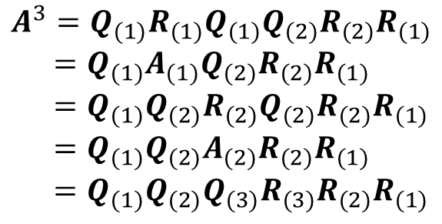

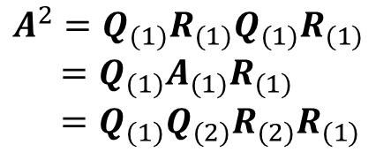
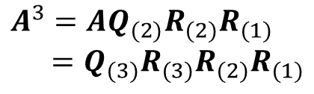
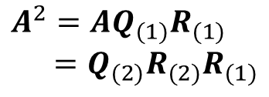

QR Algorithm
Simultaneous Iteration
QR Algorithm
$$A^{1}=Q_{(1)}R_{(1)}$$
$$A^{1}=Q_{(1)}R_{(1)}$$
$$A^{2}=AQ_{(1)}R_{(1)} \\ =Q_{(2)}R_{(2)}R_{(1)}$$
$$A^{2}=Q_{(1)}R_{(1)}Q_{(1)}R_{(1)} \\ =Q_{(1)}A_{(1)}R_{(1)} \\ =Q_{(1)}Q_{(2)}R_{(2)}R_{(1)}$$
$$A^{3}=AQ_{(2)}R_{(2)}R_{(1)} \\ =Q_{(3)}R_{(3)}R_{(2)}R_{(1)}$$
$$A^{3}=Q_{(1)}R_{(1)}Q_{(1)}Q_{(2)}R_{(2)}R_{(1)} \\ =Q_{(1)}A_{(1)}Q_{(2)}R_{(2)}R_{(1)} \\ =Q_{(1)}Q_{(2)}R_{(2)}Q_{(2)}R_{(2)}R_{(1)} \\ =Q_{(1)}Q_{(2)}A_{(2)}R_{(2)}R_{(1)} \\ =Q_{(1)}Q_{(2)}Q_{(3)}R_{(3)}R_{(2)}R_{(1)}$$
$$A^{k}=Q_{(k)}R_{(k)}R_{(k−1)}⋯R_{(1)}$$
$$A^{k}=Q_{(1)}⋯Q_{(k)}R_{(k)}⋯R_{(1)}$$

Slide 20




QR Algorithm
$$A^{k}=Q_{(k)}R_{(k)}R_{(k−1)}⋯R_{(1)}$$
$$A^{k}=Q_{(1)}⋯Q_{(k)}R_{(k)}⋯R_{(1)}$$
$${\left(Q_{(k)}R_{(k)}R_{(k−1)}⋯R_{(1)}\right)}_{SI}={\left(Q_{(1)}⋯Q_{(k)}R_{(k)}⋯R_{(1)}\right)}_{QR}$$
Angle-preserving
Length-preserving
All Q_{(k)} are orthogonal matrix.
QR factorization is unique.
$${\left(R_{(k)}⋯R_{(1)}\right)}_{SI}={\left(R_{(k)}⋯R_{(1)}\right)}_{QR}$$
$${\left(Q_{(k)}\right)}_{SI}={\left(Q_{(1)}⋯Q_{(k)}\right)}_{QR}$$

Slide 21
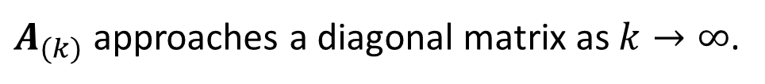

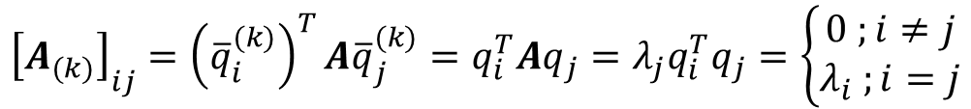

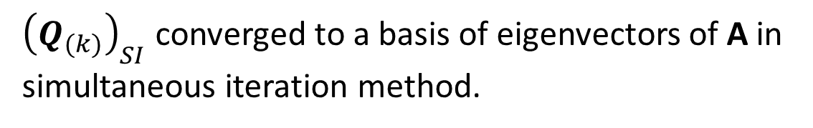

QR Algorithm
$$A_{(k)}=Q_{(k)}^{T}AQ_{(k)}$$
$$A_{(k)}={\left(Q_{(1)}⋯Q_{(k)}\right)}^{T}AQ_{(1)}⋯Q_{(k)}$$
$${\left(Q_{(k)}\right)}_{SI}={\left(Q_{(1)}⋯Q_{(k)}\right)}_{QR}$$
${\left(Q_{(k)}\right)}_{SI}$ converged to a basis of eigenvectors of A in simultaneous iteration method.
$$A_{(k)}={\left(Q_{(1)}⋯Q_{(k)}\right)}^{T}AQ_{(1)}⋯Q_{\left(k\right)}={\overline{Q}}_{(k)}^{T}A{\overline{Q}}_{(k)}$$
$${\left[A_{(k)}\right]}_{ij}={\left({\overline{q}}_{i}^{(k)}\right)}^{T}A{\overline{q}}_{j}^{(k)}=q_{i}^{T}Aq_{j}=λ_{j}q_{i}^{T}q_{j}=\left\{\begin{aligned}0 ;i≠j \\ λ_{i} ;i=j\end{aligned}\right.$$
$A_{(k)}$ approaches a diagonal matrix as $k→∞$.

Slide 22




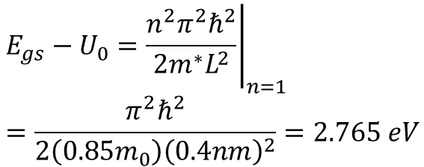

Application: Trap Potential Well
Flat-band condition
Approximation from infinite square well
$$E_{gs}−U_{0}={\left.\frac{n^{2}π^{2}ℏ^{2}}{2m^{∗}L^{2}}\right|}_{n=1} \\ =\frac{π^{2}ℏ^{2}}{2\left({0.85m}_{0}\right){\left(0.4nm\right)}^{2}}=2.765 eV$$
SBO
$$\frac{qφ_{B}+3.34}{2}$$
$$qφ_{B}$$
$$E_{C}$$
$$E_{Fn}$$
1. Assume the trapped elementary charge will be confined within a 0.4 nm width region.
2. Assume the trap level aligns with the conduction band edge of Si at flat band condition.
HK
Si
2.765 eV
$$0.4 nm$$

Slide 23

Inadequate for scattering states
Assume $ψ\sim 0$ at boundary

Slide 24
[eV]
0.4 nm trap diameter
[nm]

Slide 25
SBO
Trap
HK
[eV]
N = 0
Ground state wave function
0.4 nm trap diameter
Egs = -2.3 eV
[nm]

Slide 26
SBO
Trap
HK
[eV]
N = 1
Ground state wave function
0.4 nm trap diameter
Egs = -1.79 eV
[nm]

Slide 27
Ground state wave function
0.4 nm trap diameter

Slide 28

N = 0; Vg > 0
E3 = 2.38 eV
2.42 eV
E2 = 1.48 eV
1.5 eV
E1 = 0.49 eV
0 eV
HK
SBO
HK
SBO
2.765 eV
E0 = -2.30 eV
$$0.4 nm$$

Slide 29




SBO
Trap
HK
$$φ_{0}$$
$$φ_{2}$$
E0 = -2.30 eV
E1 = -0.49 eV
E2 = -1.48 eV
E3 = -2.38 eV
$$φ_{3}$$
$$φ_{1}$$

Slide 30




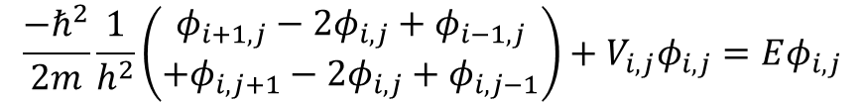




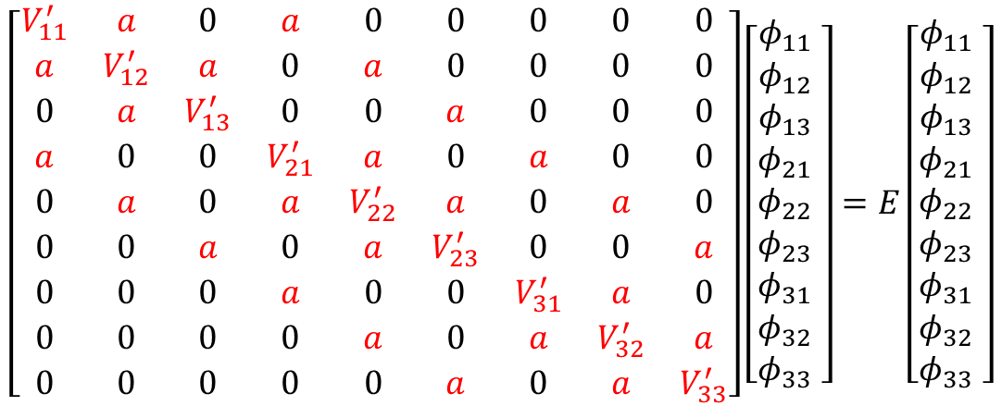





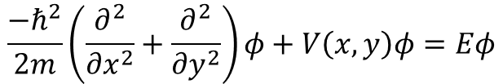
Application: 2D Potential
$$5×5$$
$$\frac{{−ℏ}^{2}}{2m}\left(\frac{∂^{2}}{{∂x}^{2}}+\frac{∂^{2}}{{∂y}^{2}}\right)φ+V\left(x,y\right)φ=Eφ$$
$$φ_{31}$$
$$φ_{32}$$
$$φ_{33}$$
$$φ_{21}$$
$$φ_{22}$$
$$φ_{23}$$
$$\frac{{−ℏ}^{2}}{2m}\frac{1}{h^{2}}\left(\begin{aligned}φ_{i+1,j}−2φ_{i,j}+φ_{i−1,j} \\ +φ_{i,j+1}−2φ_{i,j}+φ_{i,j−1}\end{aligned}\right)+V_{i,j}φ_{i,j}=Eφ_{i,j}$$
$$φ_{10}$$
$$φ_{11}$$
$$φ_{12}$$
$$φ_{13}$$
$$φ_{14}$$
$$a=\frac{{−ℏ}^{2}}{2m}\frac{1}{h^{2}}; V_{ij}^{′}=V_{i,j}−4a$$
$$\left[\begin{matrix}V_{11}^{′} & a & 0 & a & 0 & 0 & 0 & 0 & 0 \\ a & V_{12}^{′} & a & 0 & a & 0 & 0 & 0 & 0 \\ 0 & a & V_{13}^{′} & 0 & 0 & a & 0 & 0 & 0 \\ a & 0 & 0 & V_{21}^{′} & a & 0 & a & 0 & 0 \\ 0 & a & 0 & a & V_{22}^{′} & a & 0 & a & 0 \\ 0 & 0 & a & 0 & a & V_{23}^{′} & 0 & 0 & a \\ 0 & 0 & 0 & a & 0 & 0 & V_{31}^{′} & a & 0 \\ 0 & 0 & 0 & 0 & a & 0 & a & V_{32}^{′} & a \\ 0 & 0 & 0 & 0 & 0 & a & 0 & a & V_{33}^{′}\end{matrix}\right]\left[\begin{matrix}φ_{11} \\ φ_{12} \\ φ_{13} \\ φ_{21} \\ φ_{22} \\ φ_{23} \\ φ_{31} \\ φ_{32} \\ φ_{33} \end{matrix}\right]=E\left[\begin{matrix}φ_{11} \\ φ_{12} \\ φ_{13} \\ φ_{21} \\ φ_{22} \\ φ_{23} \\ φ_{31} \\ φ_{32} \\ φ_{33} \end{matrix}\right]$$

Slide 31
Application: 2D Potential
Square Well
Harmonic Potential
Calculated by MATLAB.

Slide 32
Square Well φ0

Slide 33
Square Well φ1

Slide 34
Square Well φ2

Slide 35
Square Well φ3

Slide 36
Square Well φ19

Slide 37
Harmonic φ0

Slide 38
Harmonic φ1

Slide 39
Harmonic φ2

Slide 40
Harmonic φ3

Slide 41
Harmonic φ10

Slide 42
Difficulties for 2D and 3D Simulation
For 2D case: (square wall)
41 mesh points each direction.
81 mesh points each direction.
1,681 * 1,681 matrix.
6,561 * 6,561 matrix.
2,825,761 (=41⁴) elements.
43,046,721 (=81⁴) elements.
Within 10 seconds.
few minutes.
For 3D case:
Simulation time.
41 mesh points each direction.
68,921 * 68,921 matrix.
Efficient methods for computing eigenvalues and eigenvectors are necessary.
4,750,104,241 (=41⁶) elements.

Slide 43
Quizzes for graduate students
Use m = m₀ (electron rest mass)
Please compute the eigenenergy numerically and plot the wave-function of the first 4 states of the parabolic potential. Then compare your results with the analytic formula.
5 eV
1 nm
1 nm

Slide 44
Quizzes for graduate students
1 nm
2 eV
1 nm
1 nm
1 nm
Please compute the eigenenergy numerically and plot the wave-function of the first 2 states of the left-hand side potential. Then compare your results with the infinite square well on the right-hand side. What happen if you double the potential energy in the middle of the left-hand side potential?

